Slide 1


An Exploratory Study of Parental Attachment Styles and Their Influence on Child Development and Behavioral Outcomes
SCHOOL OF ENGINEERING AND SCIENCE
DEPARTMENT OF APPLIED SCIENCE AND HUMANITIES
S.Y M.Sc. (Applied Statistics – Data Science)
PRESENTED BY
Gaurav B. Bhoite MITU22MSDS0008
Saurabh V. Bhosale MITU22MSDS0032
Under the Guidance
Dr. Pratibha Jadhav

Slide 2

Agenda:
Introduction
Data Description
Objective
Exploratory Data Analysis
Analysis Using Software
Conclusion

Slide 3

Introduction:
Brief Summary on topic.
Definition of parenting Attachment styles.
Impact on child development.
Attachment theory.
Long term implication.

Slide 4
Data Description:
The primary data, which is related to the study on how parental attachment styles influence their children's behavior,
Here's a breakdown of the potential categories:
Parent Information:
Parent_age:
Parent_Gender:
Child Information:
Child_Age:
Child_Gender:
Number_of_Children:
Family_members:
Parenting Style and Behavior:
Parental_Attachment:
Parenting_Approach:
Comfort_Expressing_Emotions:
Response_to_Needs:
Child Development and Outcomes:
Relationship_with_child:
Behavioral_Problems:
Interaction_with_Others:
Academic_Performance:
Socioeconomic factors:
Education_Level:
Both_parents_working_full_time
Employment_Status:
arent-Child Activities:
Bonding_activities_with_child:
Potential Additional Category:
Affected_Relationship_with_child:

Slide 5
Objective:
To determine the relationship between parenting attachment styles and child interaction as well as behavior quality.
To determine whether there is a relationship among different age groups of parents to expressing emotions.
To identify and analyze the different variables affecting children’s academic performance
To Study the Effects of Parental Attachment and Parenting Style on the Quality of the Parent-Child Relationship.
To investigate the association between parenting approaches and parent’s interactions with children.
To build predictive models for child behavioral problems and identify the most influential Variables.

Slide 6
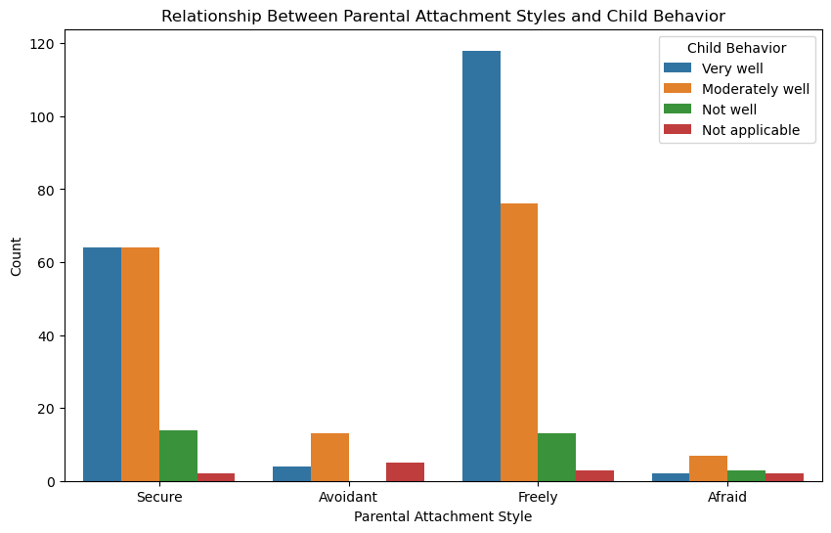
Exploratory Data Analysis:
Relation Between Parental Attachment Style & Child Behaviour :
Interpretation: From the above graph we can understand that in freely parenting attachment style child behaviour is very well to interact with other peoples.

Slide 7
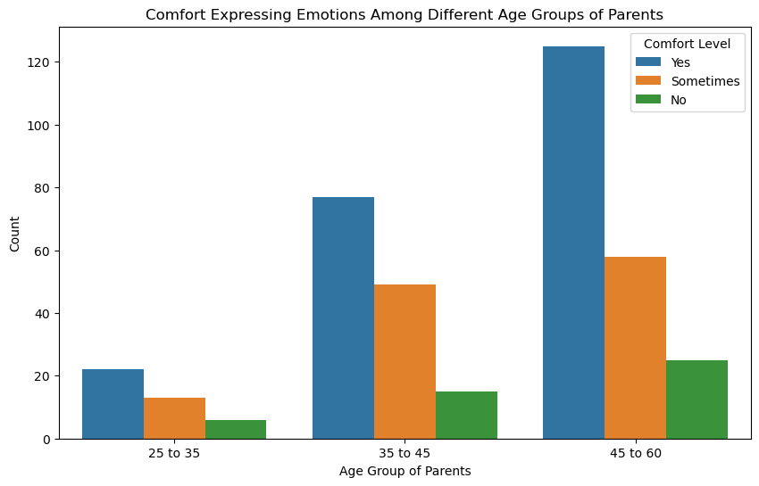
Comfort of Expressing Emotions Among Different Age Groups of Parents:
Interpretation: The following bar diagram shows that child's can comfortably expressing their emotions to parent age group between 45 to 60.

Slide 8
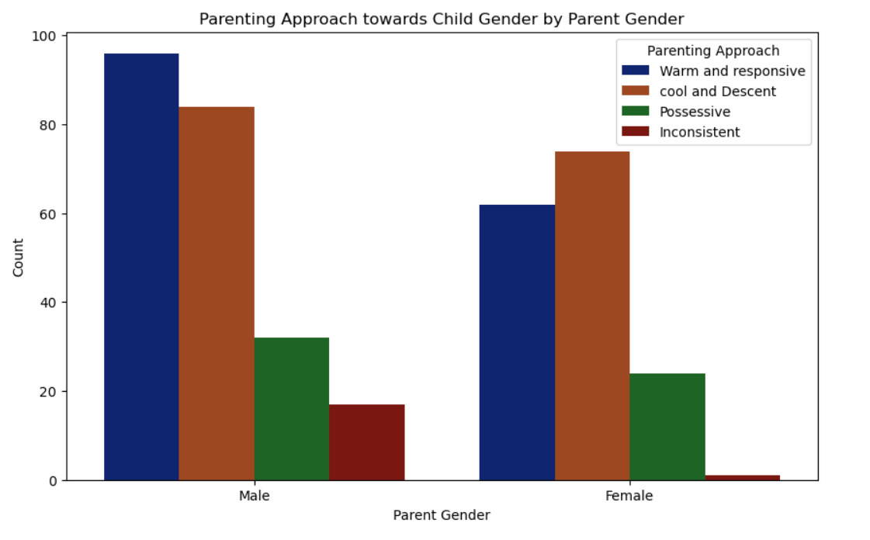
Parenting Approach Towards Child:
Interpretation:From above graph we can conclude that there is difference in parenting approach towards child gender.

Slide 9
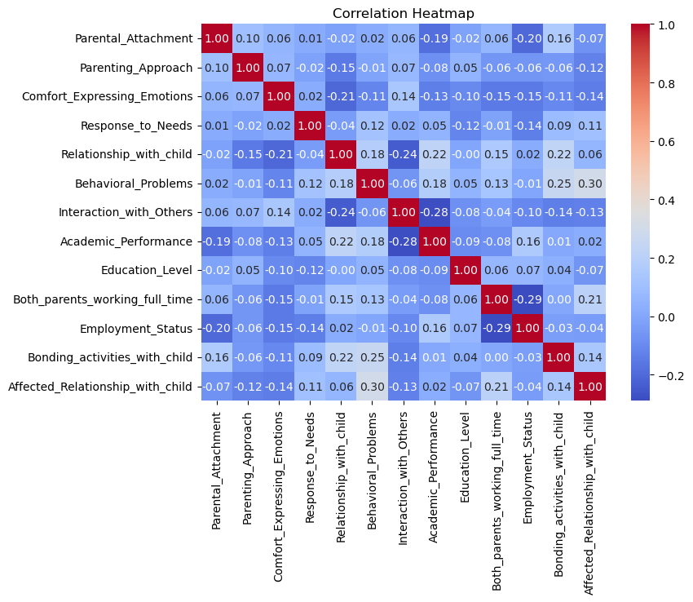
Heatmap:

Slide 10
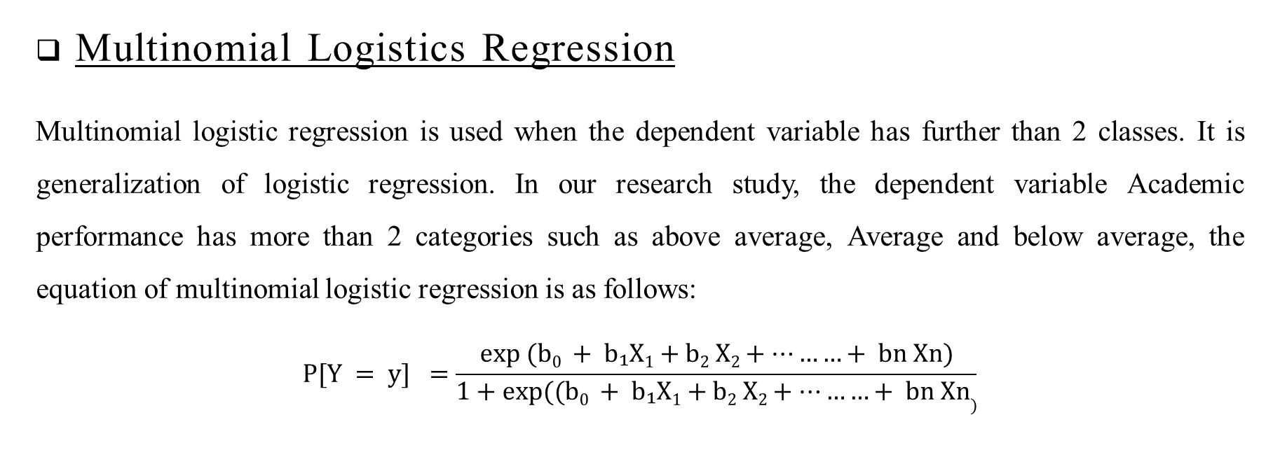
To identify and analyze the different variables affecting children’s academic performance:
Analysis Using Software:
Multinomial Logistics Regression
Multinomial logistic regression is used when the dependent variable has further than 2 classes. It is generalization of logistic regression. In our research study, the dependent variable Academic performance has more than 2 categories such as above average, Average and below average, the equation of multinomial logistic regression is as follows:
$$P[Y = y] =\frac{exp (b0 + b₁X1+b2 X2+………+ bn Xn)}{1+exp⁡((b0 + b₁X1+b2 X2+………+ bn Xn)}$$

Slide 11
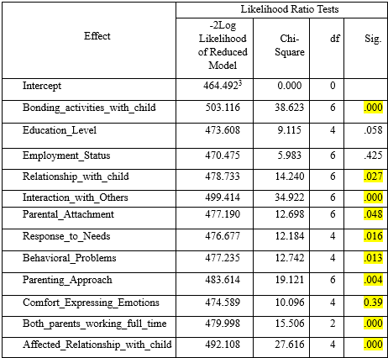
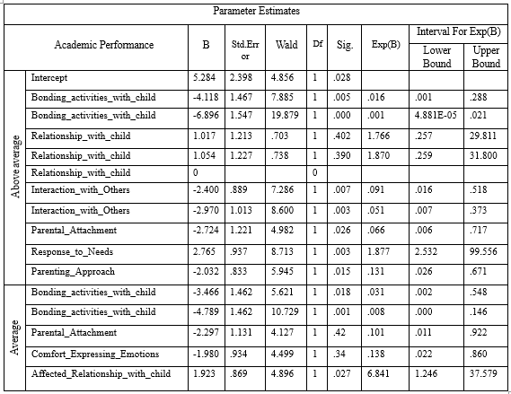
Likelihood Ratio Test Table
Parameter Estimation Table

Slide 12
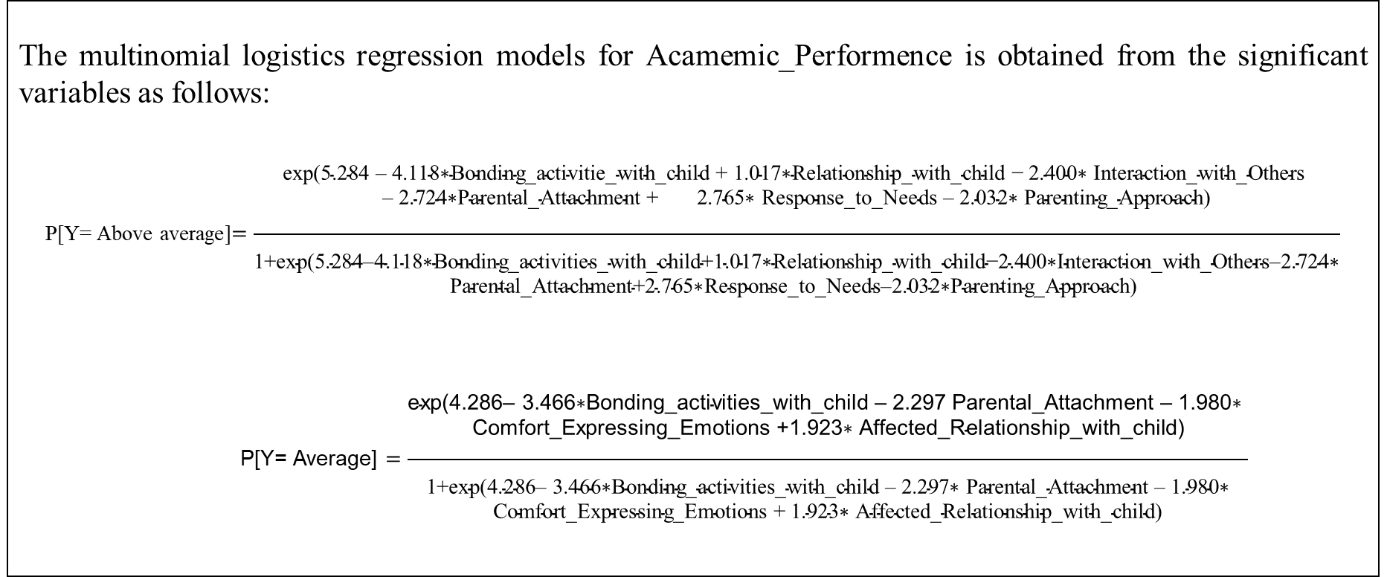
Model Estimation
The multinomial logistics regression models for Acamemic_Performence is obtained from the significant variables as follows:
P[Y= Above average]$=\frac{\begin{aligned}\text{exp}\text{(5.284 – 4.118∗}\text{Bonding}\text{_}\text{activitie}\text{_}\text{with}\text{_}\text{child}\text{ + 1.017∗}\text{Relationship}\text{_}\text{with}\text{_}\text{child}\text{ − 2.400∗ }\text{Interaction}\text{_}\text{with}\text{_}\text{Others} \\ \text{– 2.724∗}\text{Parental}\text{_}\text{Attachment}\text{ + 2.765∗ }\text{Response}\text{_}\text{to}\text{_}\text{Needs}\text{ – 2.032∗ }\text{Parenting}\text{_}\text{Approach}\text{)} \\ \\ \end{aligned}}{\begin{aligned} \\ \text{1+}\text{exp}\text{(5.284–4.118∗}\text{Bonding}\text{_}\text{activities}\text{_}\text{with}\text{_}\text{child}\text{+1.017∗}\text{Relationship}\text{_}\text{with}\text{_}\text{child}\text{−2.400∗}\text{Interaction}\text{_}\text{with}\text{_}\text{Others}\text{–2.724∗} \\ \text{Parental}\text{_}\text{Attachment}\text{+2.765∗}\text{Response}\text{_}\text{to}\text{_}\text{Needs}\text{–2.032∗}\text{Parenting}\text{_}\text{Approach}\text{) }\end{aligned}}$
P[Y= Average] $=\frac{\begin{aligned}\text{exp}\text{(4.286– 3.466∗}\text{Bonding}\text{_}\text{activities}\text{_}\text{with}\text{_}\text{child}\text{ – 2.297 }\text{Parental}\text{_}\text{Attachment}\text{ – 1.980∗ } \\ \text{Comfort}\text{_}\text{Expressing}\text{_}\text{Emotions}\text{ +1.923∗} \text{Affected}\text{_}\text{Relationship}\text{_}\text{with}\text{_}\text{child}\text{)} \\ \end{aligned}}{\begin{aligned} \\ \text{1+}\text{exp}\text{(4.286– 3.466∗}\text{Bonding}\text{_}\text{activities}\text{_}\text{with}\text{_}\text{child}\text{ – 2.297∗ }\text{Parental}\text{_}\text{Attachment}\text{ – 1.980∗} \\ \text{Comfort}\text{_}\text{Expressing}\text{_}\text{Emotions}\text{ + 1.923∗ }\text{Affected}\text{_}\text{Relationship}\text{_}\text{with}\text{_}\text{child}\text{) }\end{aligned}}$

Slide 13
To Study the Effects of Parental Attachment and Parenting Style on the Quality of the Parent-Child Relationship by using the Kruskal-Wallis test:
To check the Normality of data by using the Shapiro-Wilk Test:
Result:
Shapiro-Wilk Test: Test Statistic = 0.852,
p-value = 0.000
Conclusion:
Therefore, we reject the null hypothesis (H0) that the data is not normally distributed.

Slide 14
Hypothesis:
The null hypothesis (H0): Parental attachment and parenting approach do not affect the quality of parent-child relationship.
The alternative hypothesis (H1): Parental attachment and parenting approach have significant impact on the quality of parent-child relationship.
Output:
1.Kruskal-Wallis Test for Parental_Attachment:
2.Kruskal-Wallis Test for Parenting_Approach:
Test Statistic: | 11.56388
P-value: | 0.0090367
Test Statistic: | 24.329815
P-value: | 2.13166e-05
Result:
The p-value of 0.009, we reject the null hypothesis, suggesting that there is a significant difference in the quality of parent-child relationship based on parental attachment levels.
Result:
The p-value is close to zero (2.1316e-05), we reject the null hypothesis, suggesting that different parenting approaches have a significant impact on the relationship with the child.

Slide 15
To find the association between parenting approaches and parent and child gender by using the Chi-Square test:
Hypothesis:
The null hypothesis (H0): There is no significant association between child gender and parenting styles.
The alternative hypothesis (H1): There is significant association between child gender and parenting styles.
Output:
Result:
P value = 5.72528E-13 < alpha value=0.05,
Here P-value is less than 0.05. Therefore we reject the Null hypothesis based on this result.
Conclusion:
There is a significant association between child gender and parenting styles, a real pattern suggesting that parents treat their children differently based on their gender.
Chi-Square Statistic: | 93.46550765
P-value: | 5.72528E-13
Degrees of Freedom: | 16

Slide 16
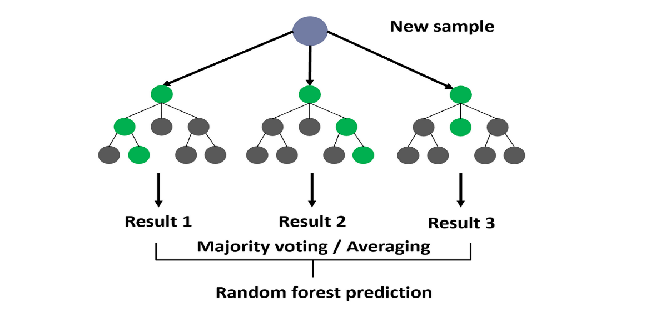
To build predictive models for child behavioral problems and identify the most influential factors:
Random Forest Classifier
Random forest is a combination of decision trees that can be modeled for prediction and behavior analysis. In random forest , it builds multiple decision trees during training and combine their predictions to improve overall accuracy.
Classification Report:
Column1 | Precision | recall | f1-score | Support
No: 0 | 0.86 | 0.98 | 0.91 | 49
Sometime: 1 | 0.94 | 0.7 | 0.8 | 23
Yes: 2 | 0.8 | 0.67 | 0.73 | 6
Accuracy |  |  | 0.87 | 78
macro avg | 0.87 | 0.78 | 0.81 | 78
weighted avg | 0.88 | 0.87 | 0.87 | 78
Overall Accuracy | 0.87
Interpretation: The overall accuracy of the random forest model is 87%.

Slide 17

Decision Tree Classifier
A decision tree is a flowchart-like tree structure where an internal node represents a feature or attribute, the branches represent a decision rule, and each leaf node represents an outcome or class label.
Classification Report:
Column1 | Precision | recall | f1-score | Support
No: 0 | 0.84 | 0.96 | 0.90 | 49
Sometime: 1 | 0.93 | 0.61 | 0.74 | 23
Yes: 2 | 0.71 | 0.83 | 0.77 | 6
Accuracy |  |  | 0.85 | 78
macro avg | 0.83 | 0.80 | 0.80 | 78
weighted avg | 0.86 | 0.85 | 0.84 | 78
Overall Accuracy | 0.85
Interpretation: The overall accuracy of the decision tree model is 85%.

Slide 18
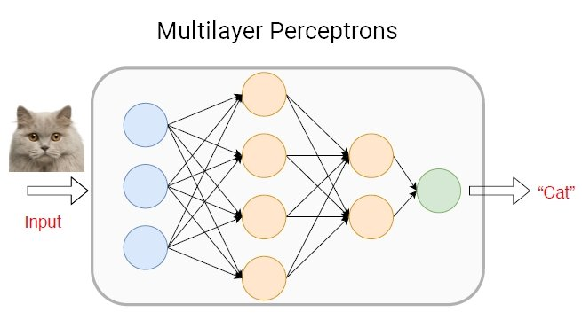
3. Multilayer Perceptron (MLP) classifier:
The Multilayer Perceptron (MLP) classifier is a type of feedforward artificial neural network (ANN) commonly used for classification tasks, MLP classifiers are powerful models capable of learning complex patterns in data, making them suitable for a wide range of classification tasks.
Classification Report:
Column1 | Precision | recall | f1-score | Support
No: 0 | 0.90 | 0.94 | 0.92 | 49
Sometime: 1 | 0.82 | 0.78 | 0.80 | 23
Yes: 2 | 1.00 | 0.83 | 0.91 | 6
Accuracy |  |  | 0.88 | 78
macro avg | 0.91 | 0.85 | 0.88 | 78
weighted avg | 0.88 | 0.88 | 0.88 | 78
Overall Accuracy | 0.88
Interpretation: The overall accuracy of the Multilayer Perceptron model is 88%.

Slide 19
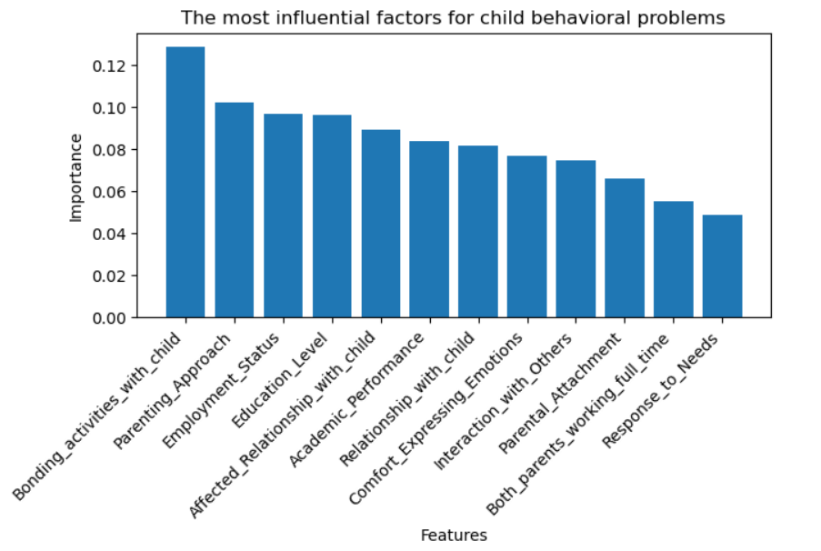
Comparing the accuracy of the models and identify the most influential factors:
Model | Accuracy
Random Forest classifier | 0.87
Decision Tree classifier | 0.85
Multilayer Perceptron (MLP) classifier | 0.88

Slide 20
Conclusion:
Parenting attachment styles significantly impact child behavior quality, with freely parenting styles enabling children to interact with parents aged 45–60 and express emotions comfortably.
The study utilized multinomial logistic regression models to identify key factors affecting children's academic performance, achieving 70.3% accuracy, offering valuable insights for parents, educators, and representatives.
By developing predictive models for child behavioral problems, we identified several influential factors. Among these factors, the level of bonding activities between parents and their children has the highest impact on predicting behavioral problems.
Our analysis indicated that there is a significant association between child gender and parenting styles. This suggests that parents treat their children differently based on their gender.
Through our analysis, we observed a significant interaction effect between parental attachment and parenting approach on the quality of the parent-child relationship.

Slide 21

Thank You

